Slide 1
Restaurant Capacity Tracker
Olivia Zhang
June 2, 2015
Computer Systems Research Lab

Slide 3
Restaurant Capacity Tracker
Real-time data from Google Maps, OpenTable, and Yelp
Calculates capacity of a restaurant and real-time crowdedness levels for restaurants
Additional Reservation, Directions functions
Improved dining experience

Slide 4
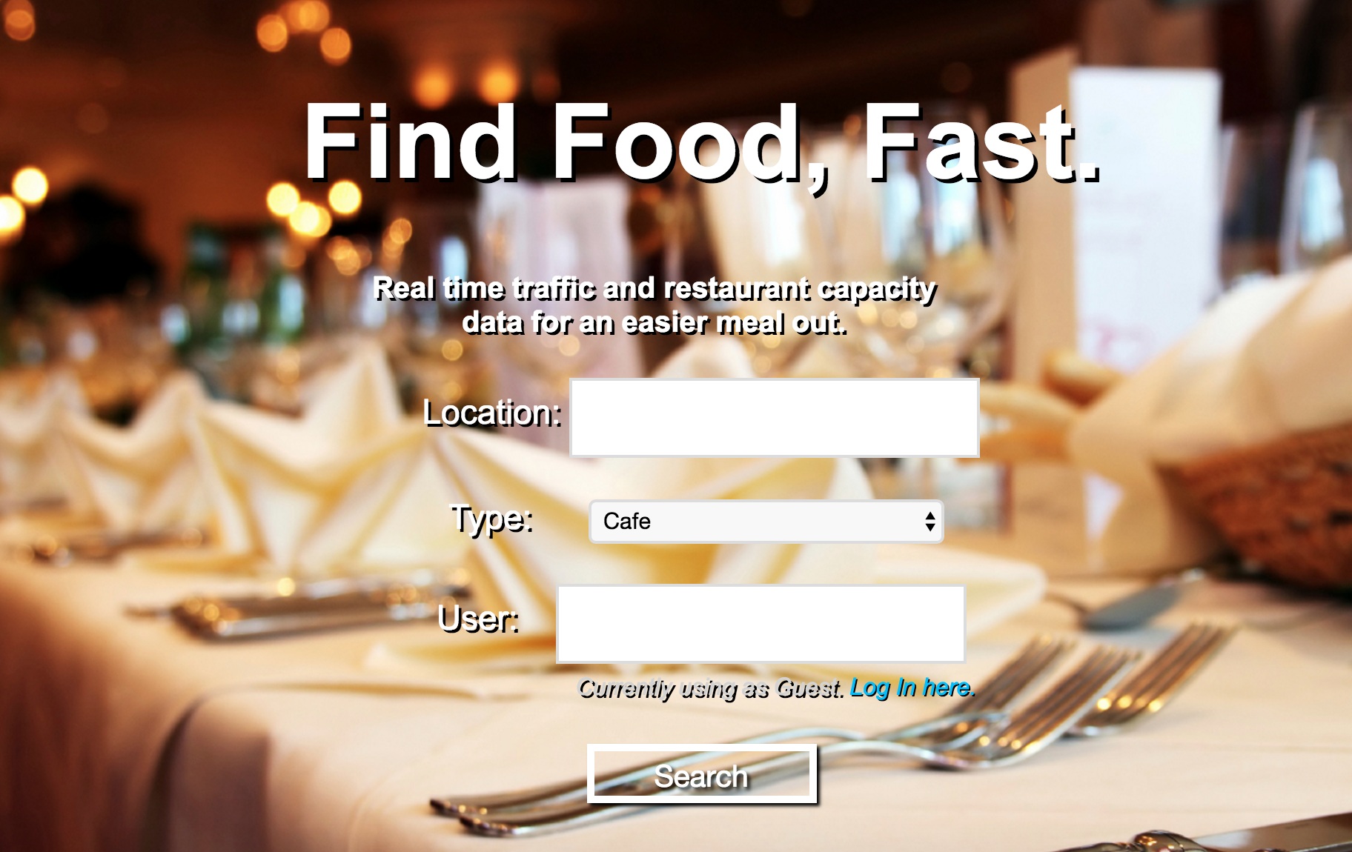
Application Structure:
Written in PHP, HTML, CSS, and Javascript
Hosted on TJ Server
Real-time restaurant capacity returned in browser
(screenshot)
Server
Notes:
Mention each service
Show app screenshot

Slide 5
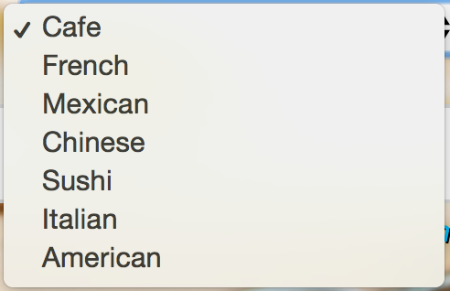
Input Page
Fields for location, restaurant type, and username
Categories and specifications
Initiates search request in Yelp Database

Slide 6
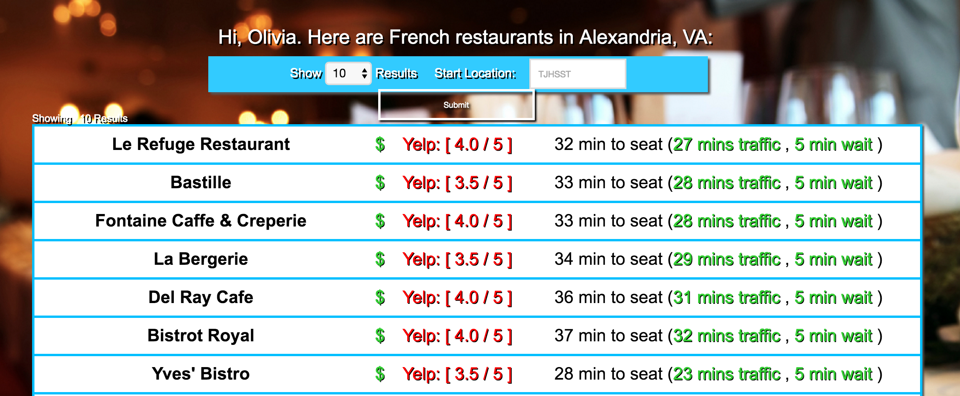
Main Search Results
Restaurant name, price range, Yelp rating, estimated traffic time, and estimated wait time displayed
Links to additional functions
Information extracted from Yelp API results using regular expressions

Slide 7
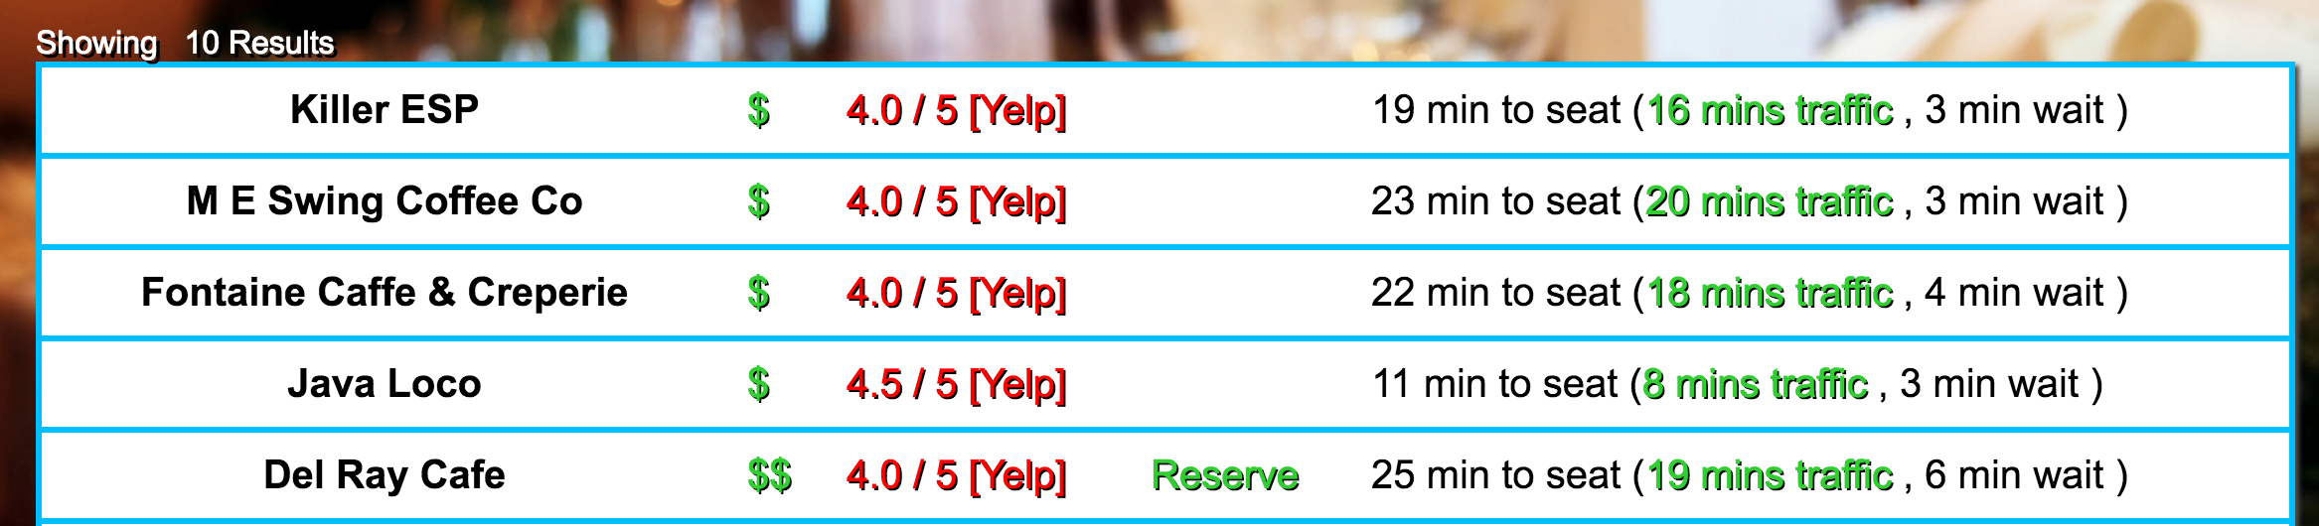
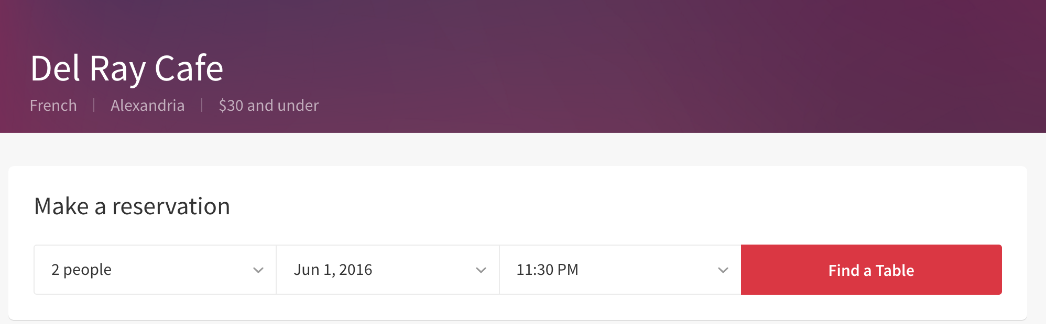
OpenTable Service
Displays link to make reservation
Not available for all restaurants

Slide 8


Traffic Calculations
Estimated driving time based on real-time traffic conditions displayed
Latitude and Longitude Values through Yelp API results
Adjustable start location for more precise routes

Slide 9
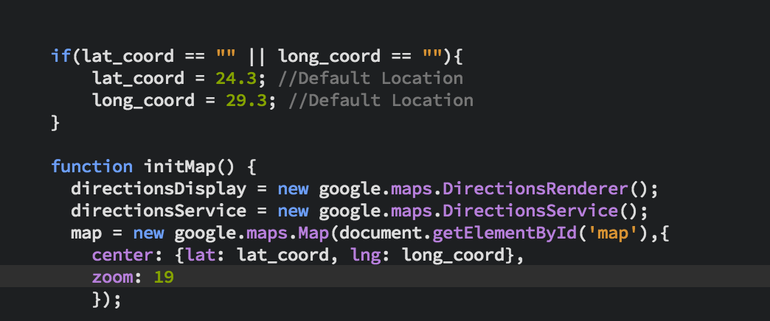
Geocoding Functionality
Google Map services use latitude and longitude values for calculations
Geocoding converts address string into latitude /longitude value
Provided as Google Service

Slide 10
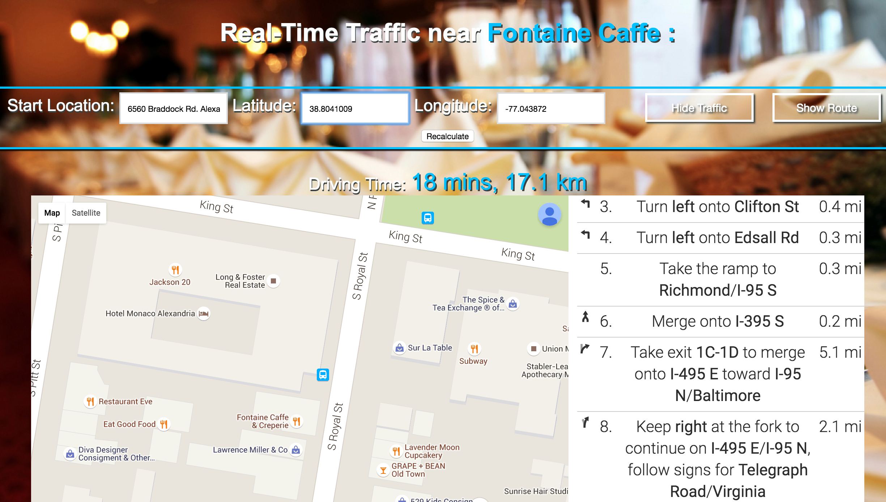
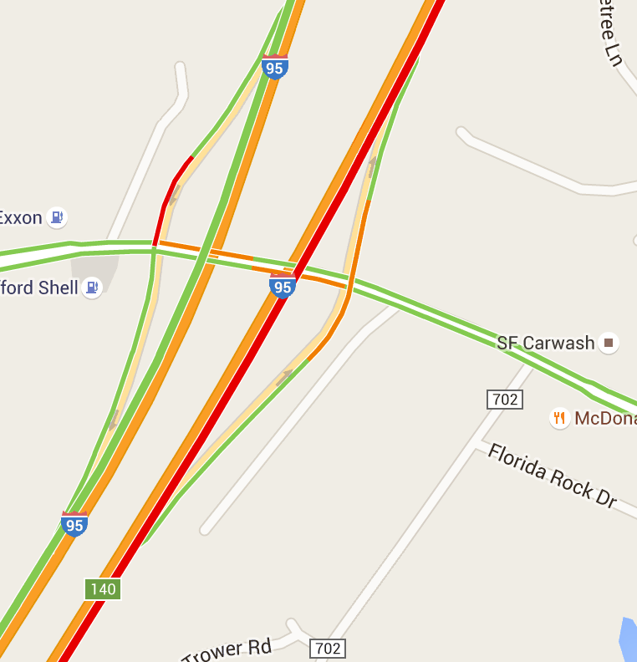
Traffic Page
Maps rendered through built-in Google JavaScript Library
Directions and travel time displayed, using real-time traffic condition
Collected from location data of Google Users

Slide 11
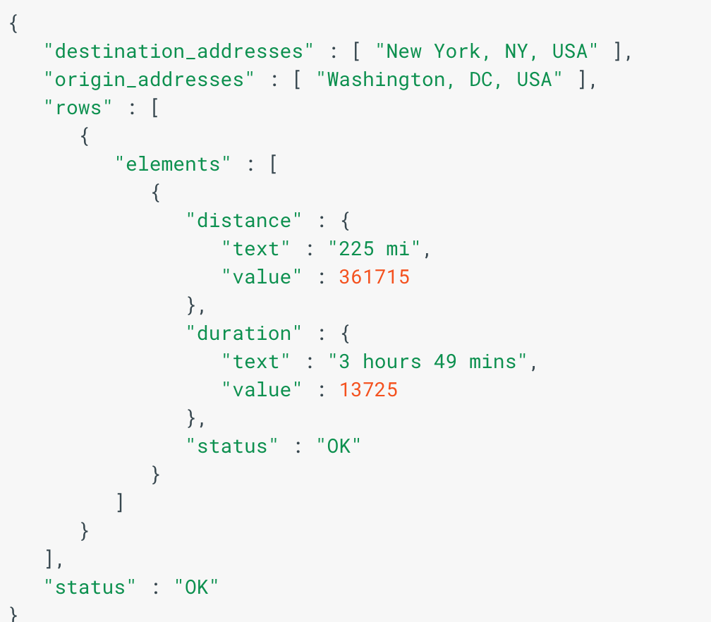
Google Distance Matrix
Distance and Duration values parsed as JSON from API results

Slide 12


User Accounts
Simplify application experience
Stored in SQLite Database
Submit capacity reports

Slide 13
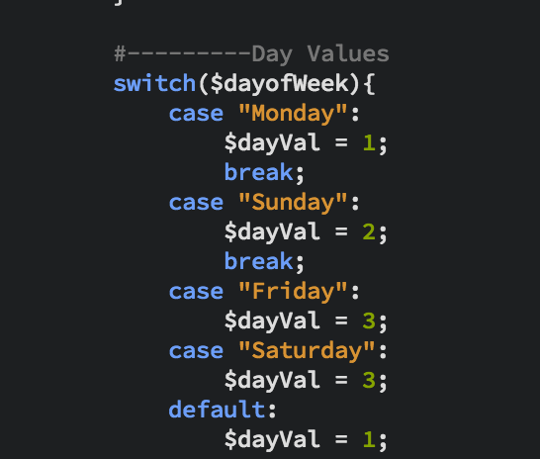
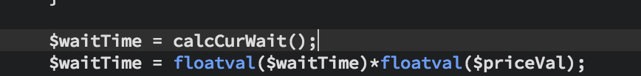

Wait Time Algorithm
Capacity represented as estimated wait time
Weighted average of number values, factoring in day of week, hour, price range, and real-time data

Slide 14
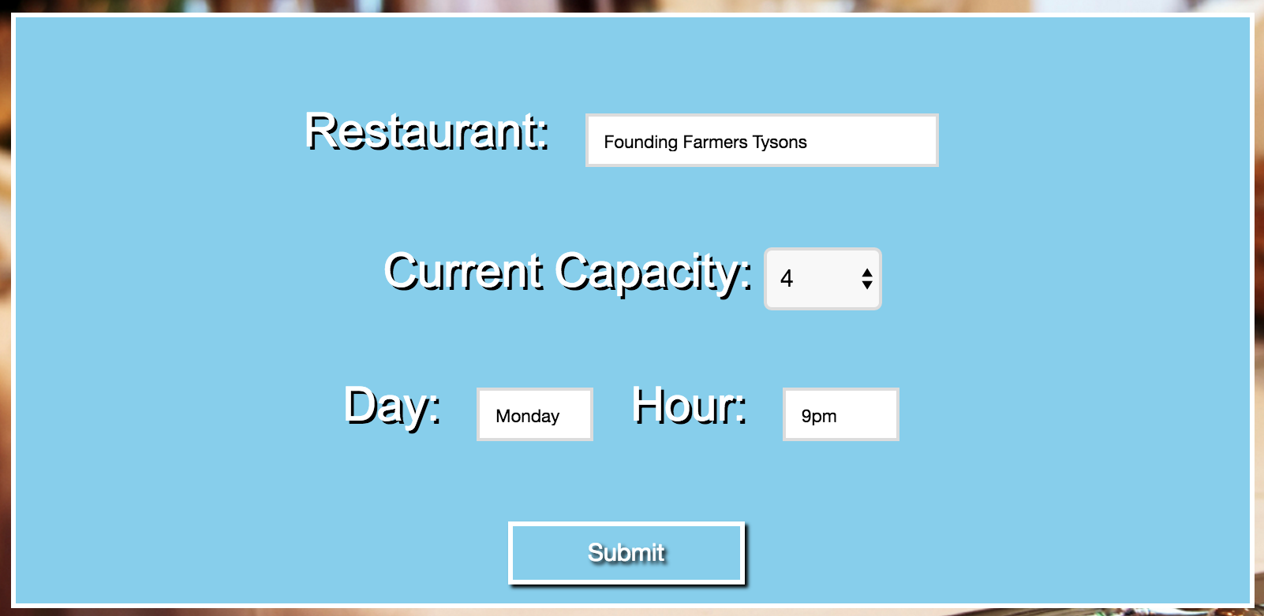
User Submitted Data
Form to report capacity values from restaurant
Integer Value 1-5
Submitted through user accounts

Slide 15
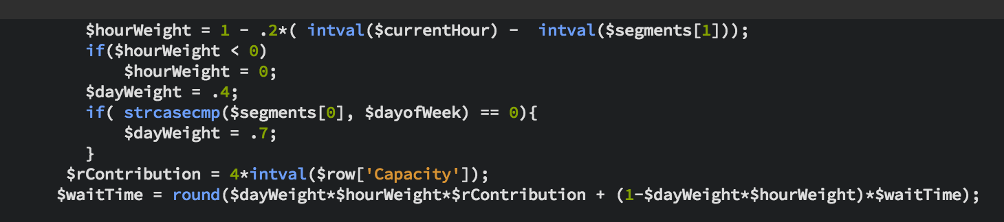
User Submitted Data (cont.)
Reported Integer Value converted into time duration
Weighting determined based on similarity of report to current day and hour
Monday 10 AM doesn’t significantly affect Friday 7 PM

Slide 16
Database Usage
User Accounts
Name, Location, Username, Password, Email
Restaurant Information
Rest. Name, Address, Price Range, Rating, and Yelp/Open Table URLS
Capacity Reviews
Rest. Name, Integer Value, Time and Date, and User submitted

Slide 17
Demo
Restaurant Capacity App

Slide 18
Summary
Streamlined view of real-time restaurant information
Directions, Ratings, Reservation Functionalities
Future improvements:
More sophisticated algorithm (Yelp Reviews and Traffic Data)
Improved speed
Expanded User Account features

Slide 19
Acknowledgements
Dr. Peter Gabor
TJ Computer Systems Lab

Slide 20
References
"Documentation." API 2.0: Overview. https://www.yelp.com/developers/documentation/v2/overview Yelp, n.d. Web. 30 Oct. 2015.
"Install Apache." Install Apache. http://www.php-tutorials.info/installApache.php Apache, n.d. Web. 30 Oct. 2015.
“PHP Manual." PHP Manual. https://secure.php.net/manual/en/index.php N.p., 29 Oct. 2015. Web. 30 Oct. 2015.
"Yelp/yelp-api.” https://github.com/Yelp/yelp-api/blob/master/v2/php/sample.php , GitHub. Web. 30 Oct. 2015.
"Google Maps Directions API | Google Developers." Google Developers. Google Developers, n.d. Web. 18 May 2016.
Sosedoff. "OpenTable API." OpenTable Public API. GitHub Repository, n.d. Web. 18 May 2016.

